Slide 1
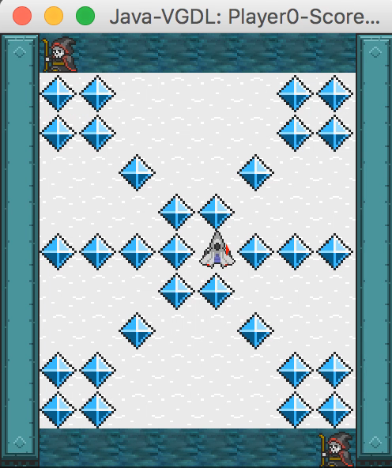
IGGI Game Design II General Video Game AI
Diego Perez-Liebana

Slide 2
Contents
The General Video Game AI Framework and Competition
2-Player GVGAI
Parameterizing GVGAI
Using GVGAI for Game Design
Today’s exercise

Slide 3
Contents
The General Video Game AI Framework and Competition
2-Player GVGAI
Parameterizing GVGAI
Using GVGAI for Game Design
Today’s exercise

Slide 4
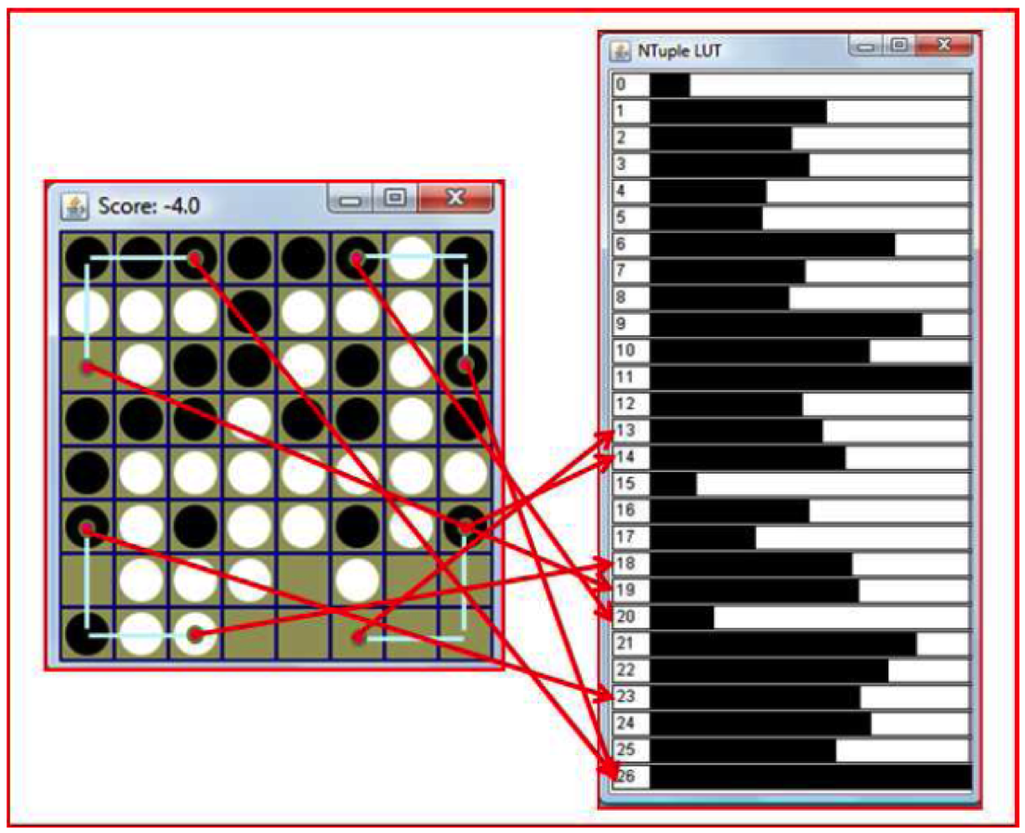

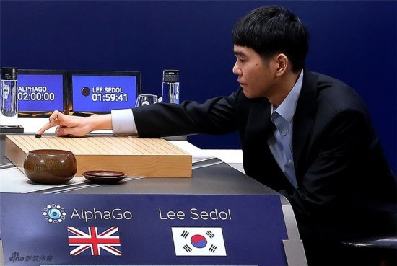
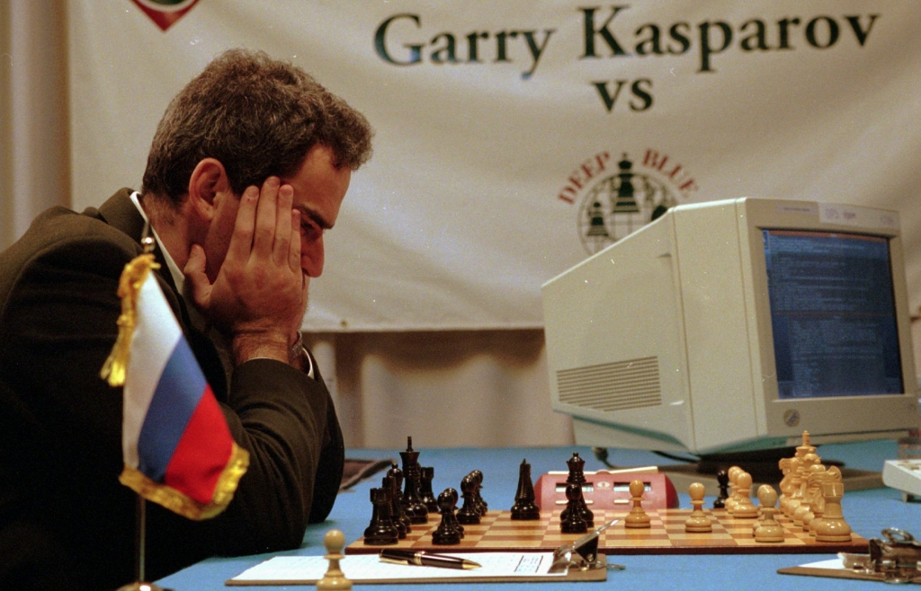
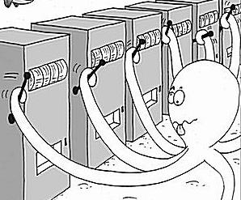
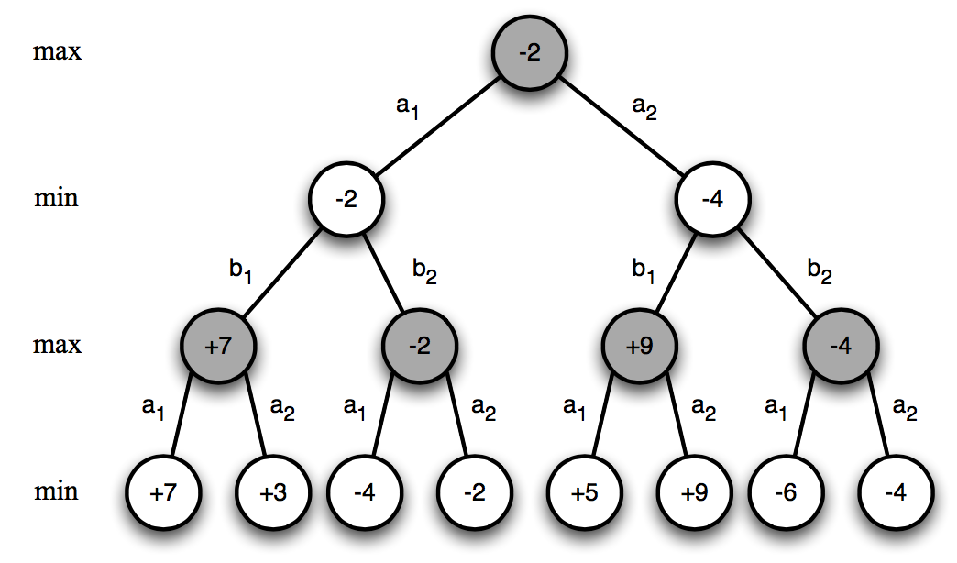
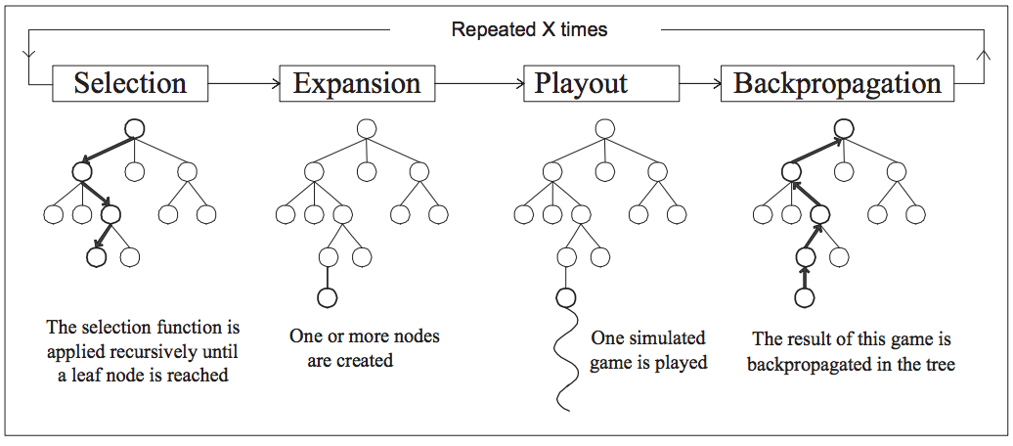
AI Research in Games
Games: Benchmarks for AI

Slide 5
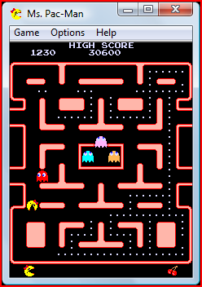
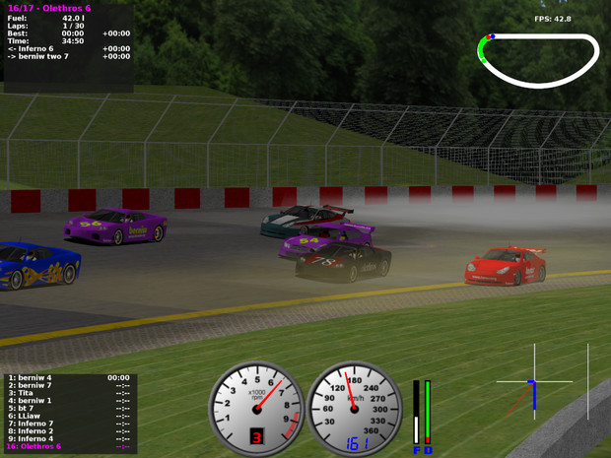
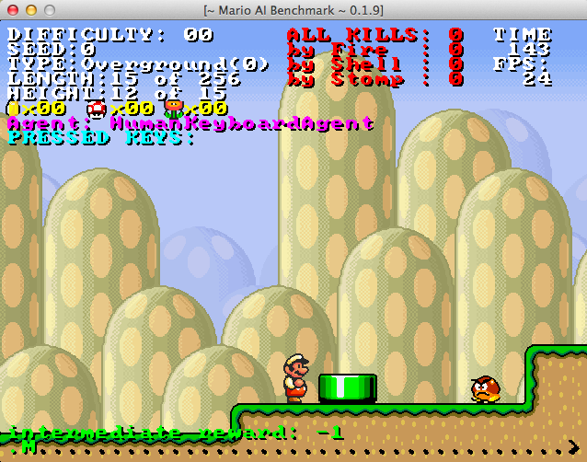

General Video Game Playing
Video game-based AI Competitions

Slide 6
General Video Game Playing
General Video Game Playing?

Slide 7
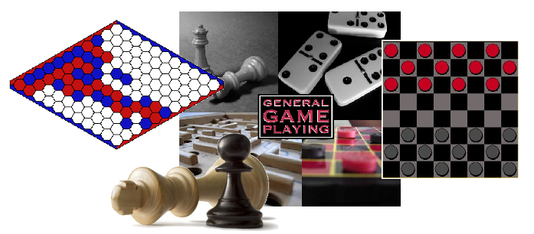
General Video Game Playing
Creating agents that can play any (board) game
First AIII GGP Competition, by the Stanford University Logic Group [Genesereth and Love, 2005]
At least 1s decision time

Slide 8
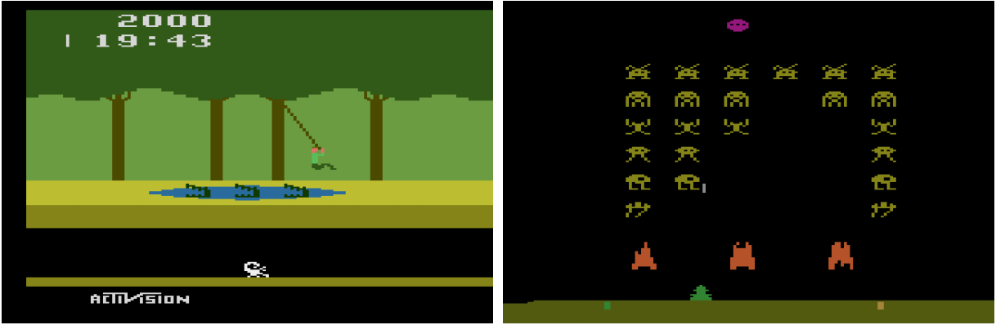
General Video Game Playing
Creating agents that can play any (real-time, arcade) game (milliseconds of decision time)
Evaluation of AI agents in domain-independent environments
Arcade Learning Environment (ALE), [Bellemare et al., 2013]: Evaluation of AI agents in 55 games of the Atari 2600 Collection
Human-level control through deep reinforcement learning [Mnih et al., 2015]

Slide 9
General Video Game Playing
Levine et al. propose the creation of a new benchmark for GVGP [Levine et al., 2013]
Compliments ALE in two ways:
Creation of games in a more general framework.
No screen capture analysis needed, information via encapsulated objects.
Video Game Description Language (VGDL) [Tom Schaul, 2013]
Benchmark for learning and planning problems.
Base for the GVGAI Framework

Slide 10
VGDL and the GVGAI Framework
A competition where competitors submit game-playing agents
Agents are tested on unseen videogames
Games are implemented in the Video Game Description Language
Notes:
Diego IN

Slide 11
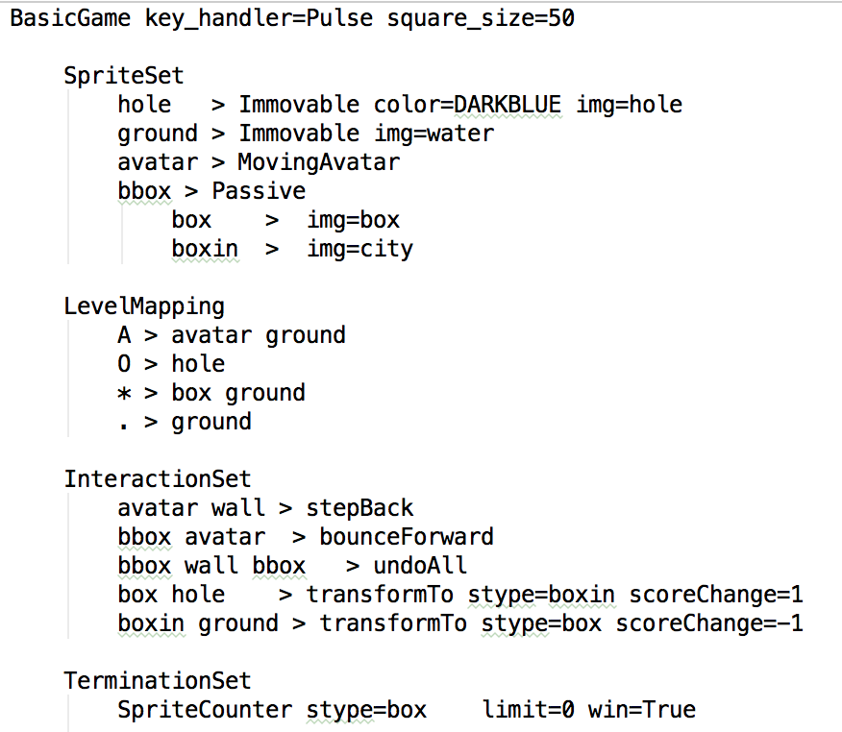
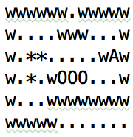
VGDL and the GVGAI Framework
(Sokoban)
https://github.com/EssexUniversityMCTS/gvgai/wiki/VGDL-Language

Slide 12
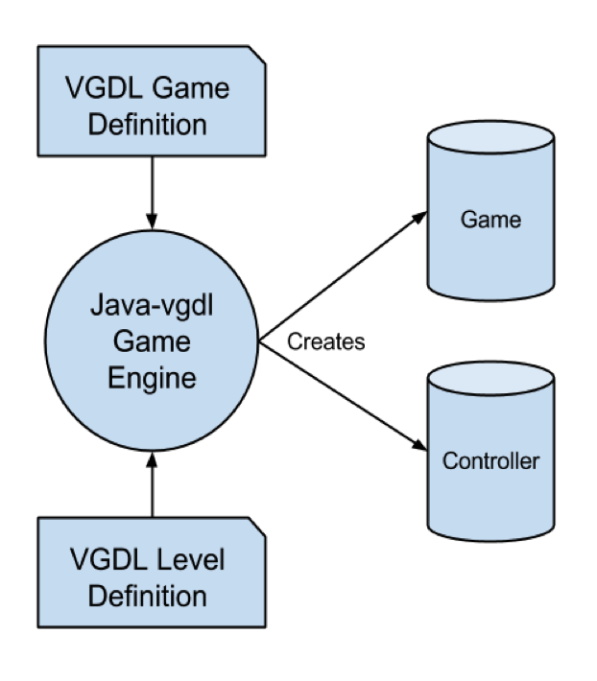
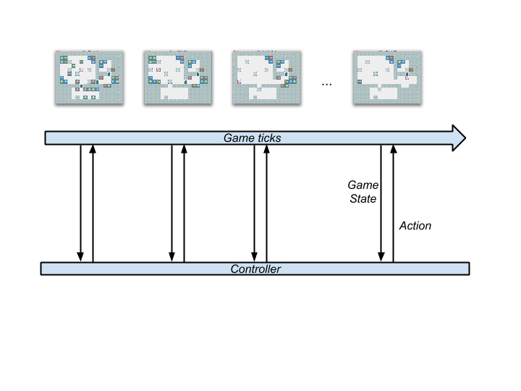
VGDL and the GVGAI Framework
The GVGAI Framework
40 ms as budget time per action.
If returns action between 40 and 50ms, NIL is applied.
If returns action after 50ms, the agent is disqualified and loses the game.

Slide 13
How GVGAI differs…
From General Game Playing:
We do videogames! Real-time constraints!
We don’t make the ruleset available
Notes:
Julian IN

Slide 14
How GVGAI differs…
From the Arcade Learning Environment (ALE):
Structured API (information via Java objects)
Potentially infinite supply of games
Agents tested on unseen games

Slide 15
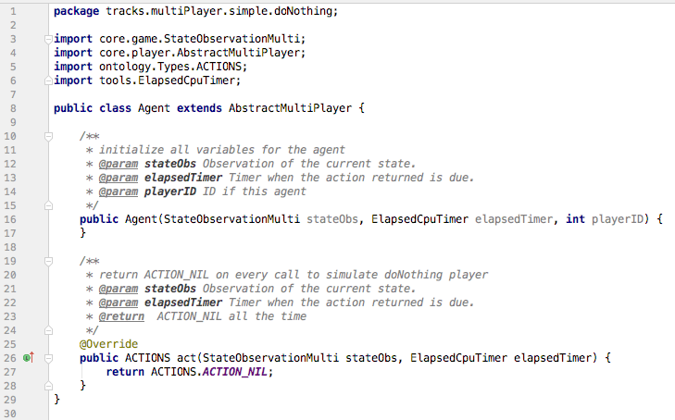
VGDL and the GVGAI Framework
It is very simple to write your first controller!

Slide 16
VGDL and the GVGAI Framework
Every time step, agents receive information:
State of the game:
Score, tick, winner, game over, world dimensions.
State of the avatar:
Position, speed, orientation, resources.
Available actions.
History of events (collisions) in the game.
Other sprites:
Observation grid.
Categorized observations (NPC, Portal, static sprites…)

Slide 17
VGDL and the GVGAI Framework
Every time step, agents can use a forward model:
copy()
advance(action)
Advances the state applying the action supplied
Allows to simulate the effects of applying actions
The games are stochastic in nature!
Next state is just a possible future state when applying an action.
Agent is responsible for dealing with these inaccuracies.

Slide 18
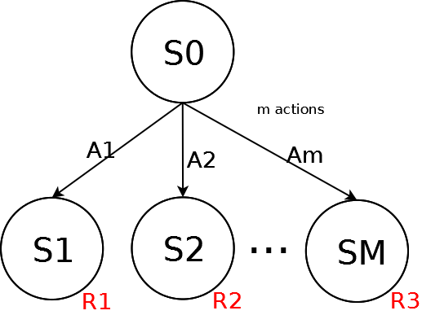
VGDL and the GVGAI Framework
Framework provides sample controllers:
Simple One Step Look Ahead:

Slide 19
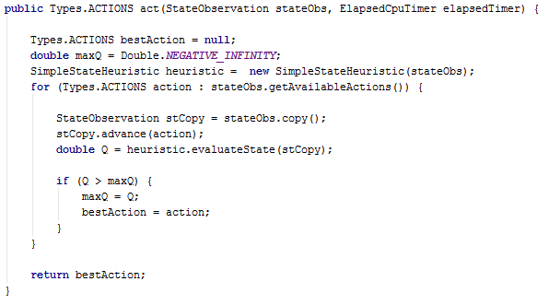
VGDL and the GVGAI Framework
Simple One Step Look Ahead:

Slide 20
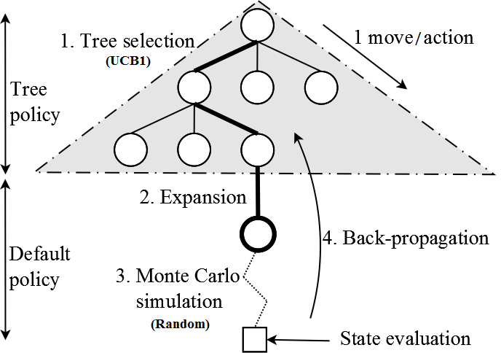
VGDL and the GVGAI Framework
Monte Carlo Tree Search (Open and Close loop)

Slide 21
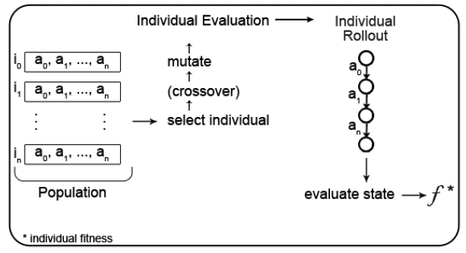
VGDL and the GVGAI Framework
Rolling Horizon Evolutionary Algorithms (RHEA)
Individual: sequence of actions to apply from the current state (open loop)
Fitness: evaluation of the state reached after applying actions
RHEA evolves the best sequence of actions in a time step
When time is up, apply first action of best individual

Slide 22
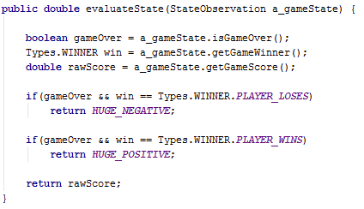
VGDL and the GVGAI Framework
Simple One Step Look Ahead:

Slide 23
VGDL and the GVGAI Framework
Current set of 100 (single player) games (90 of them public)
(Aliens)

Slide 24
VGDL and the GVGAI Framework
(Butterflies)

Slide 25
VGDL and the GVGAI Framework
(Pac Man)

Slide 26
VGDL and the GVGAI Framework
(Sequest)

Slide 27
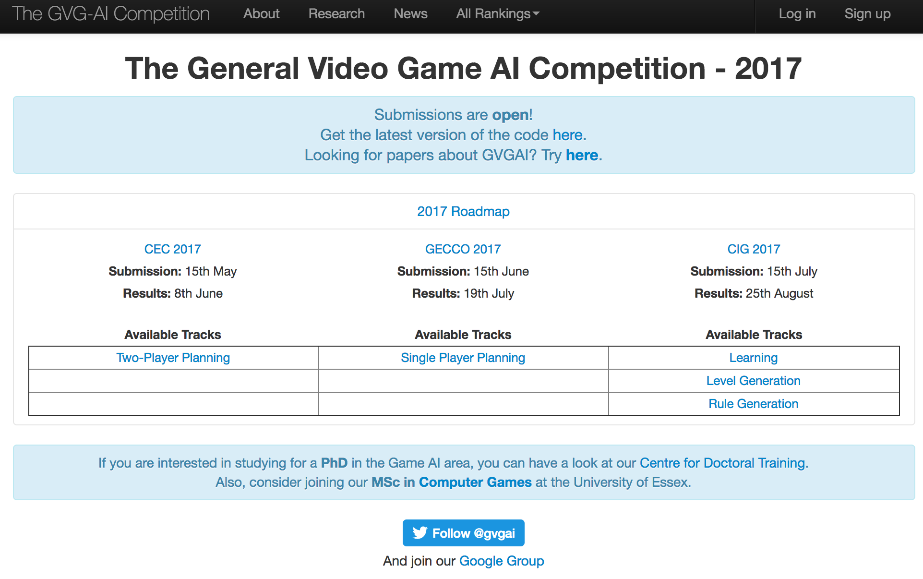
The GVGAI Competition – www.gvgai.net
Competition Structure:
N Game Sets, 10 games each, 5 levels per game.
Training Set: 10 games distributed with the framework.
Validation Set: 10 games, unknown to the participants.
Test Set: 10 games, unknown, and only executed in once.

Slide 28
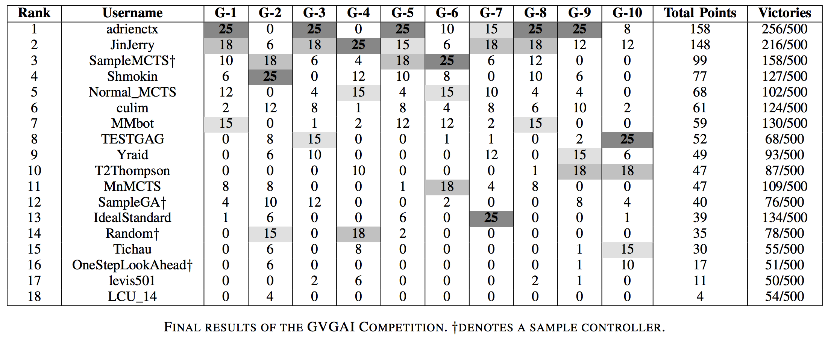
The GVGAI Competition – www.gvgai.net
IEEE CIG 2014 Competition results:
Winner: Adrien Couëtoux (51.2%) [Perez et al., 2015]

Slide 29
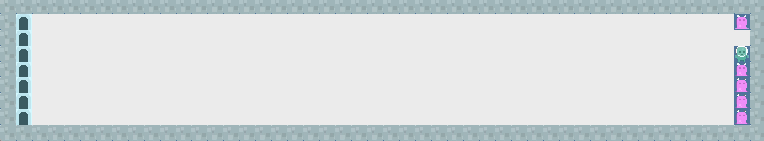
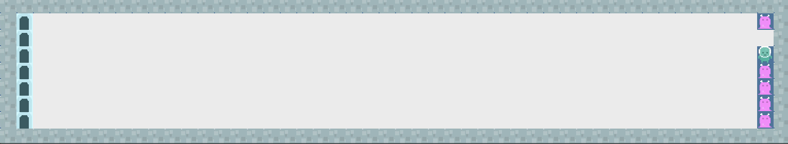
The GVGAI Competition – www.gvgai.net
adrienctx– 1st Position
IdealStandard – 13th Position

Slide 30
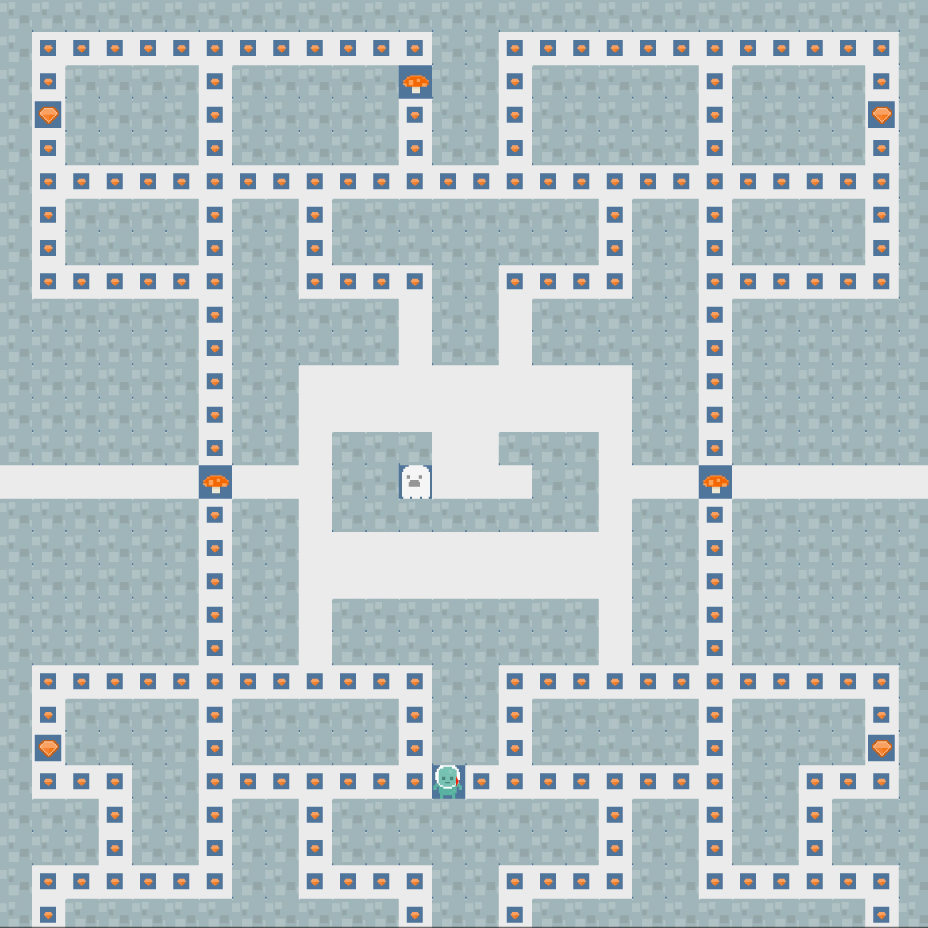
IdealStandard – 13th Position

Slide 31
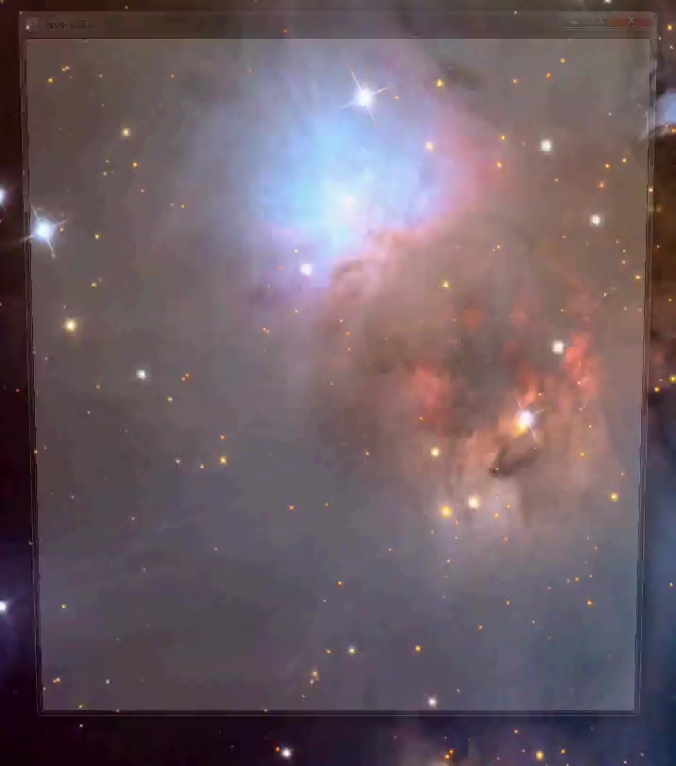
adrienctx– 1st Position

Slide 32
The GVGAI Competition – www.gvgai.net
GVGAI 2015 Competition:
ACM GECCO (July 2015)
Winner: YOLOBOT (63.8%; MCTS, BFS, Sprite Targeting Heuristic)
IEEE CIG (August 2015)
Winner: Return42 (35.8%; GA w/ heuristic, random walks, A*)
IEEE CEEC (September 2015)
Winner: YBCriber (39.2%; Iterative Widening, Danger Avoidance)
GVGAI 2016 Competition:
IEEE CIG (September 2016)
Single-Player Winner: YOLOBOT (41.6%)
Two-Player Winner: adrienctx (271 points)
IJCAI (July 2016)
Level Generation Winner: easablade (35% preferred)

Slide 33
The GVGAI Competition – www.gvgai.net
GVGAI 2017 Competition: 5 tracks
Single Player Planning Track:
YOLOBOT – 42.4%
Two-Player Planning Track:
TOVO2 (161 points)
A Sarsa-UCT algorithm, using TD backups and space-local Q-value normalization.
Learning Track:
kkunan - 12% victories
QLearning with Avatar Features
Level Generation Track; and Rule Generation Track:
Not enough submissions

Slide 34
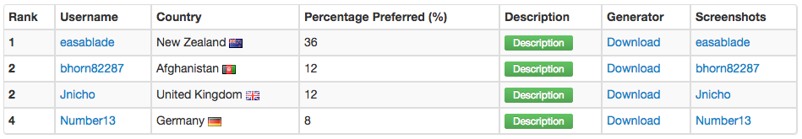
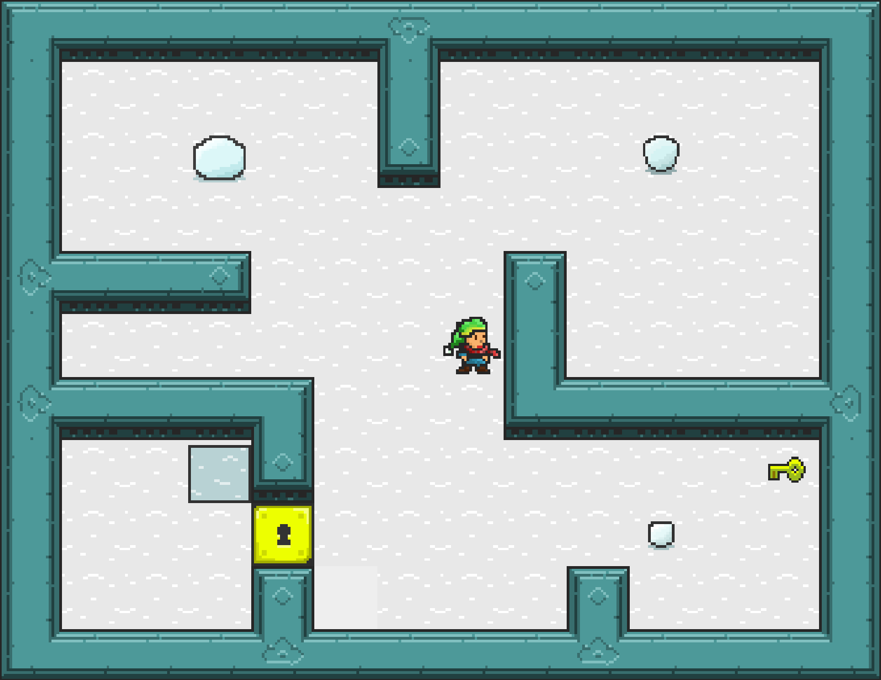
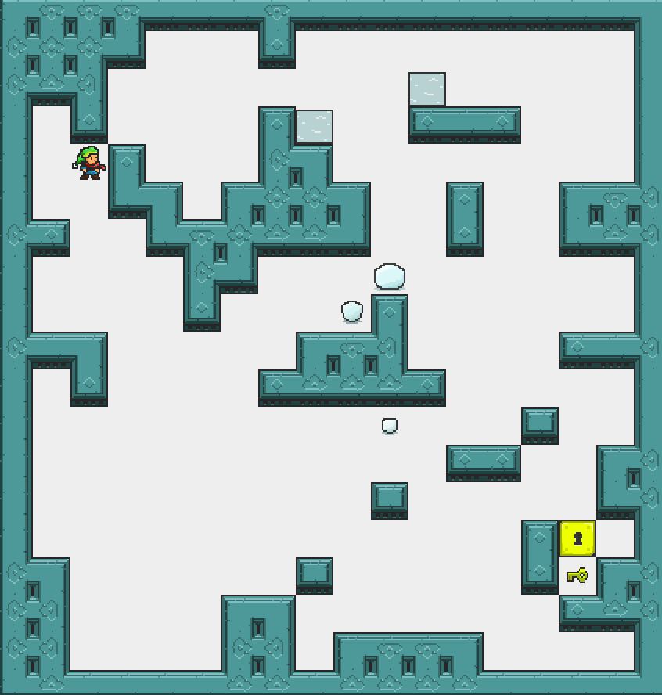
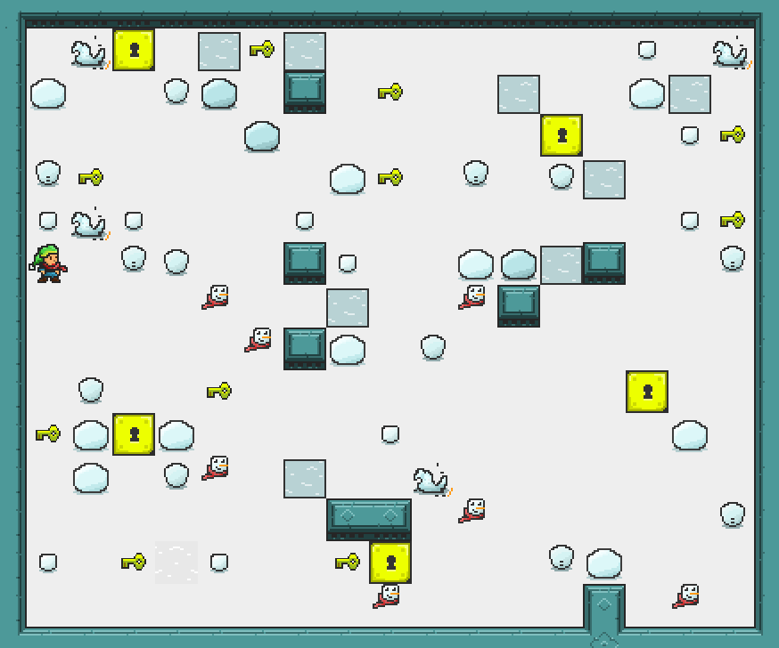
The GVGAI Competition – www.gvgai.net
GVGAI 2016 Competition - Level Generation Track:

Slide 35
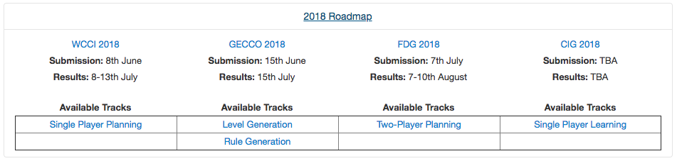
The GVGAI Competition – www.gvgai.net
Planning and PCG Tracks:
https://github.com/GAIGResearch/GVGAI
Learning track:
https://github.com/rubenrtorrado/GVGAI_GYM

Slide 36
Contents
The General Video Game AI Framework and Competition
2-Player GVGAI
Parameterizing GVGAI
Using GVGAI for Game Design
Today’s exercise

Slide 37
The 2-Player GVGAI Planning Track
2 players compete (or cooperate) in real-time games of simultaneous moves.
40 training games, all play versus all, or using Glicko2 pairing system.
10 validation (and 10 test extra games).
Separated interface for 2 (N) player game agents.

Slide 38
The 2-Player GVGAI Planning Track
50 Games: accelerator, akkaarrh, asteroids, beekeeper, bombergirl, breedingdragons, captureflag, competesokoban, copsNrobbers, donkeykong, dragonattack, drowning, egghunt, fatty, firetruck, football, ghostbusters, gotcha, isawsanta, klax, mimic, minesweeper, minions, oopsbrokeit, reflection, rivalry, romeoNjuliet, samaritan, sokoban, steeplechase, teamescape, thebridge, trainride, treasuremap, tron, upgrade-x, uphigh, warzone, watchout and wheelme.
5 levels per game
Descriptions
Set 1: http://www.gvgai.net/training_set.php?rg=2001
Set 2: http://www.gvgai.net/training_set.php?rg=2002
etc…

Slide 39
2-Player VGDL
VGDL
Game definition (first line)
Keywork BasicGame
Parameters:
no_players=N (default: 1).
square_size=N
key_handler={Pulse, Input} (default: Input).
Example (Akka Arrh):

Slide 40
2-Player VGDL
VGDL
Sprite Set: defines the sprites that can appear in the game.
Sprite name
Sprite type (defined in the ontology – Java class):
Immovable, Portal, Resource, MovingAvatar, RandomNPC, …
Each type allows certain parameters:
Common: singleton, img, speed, invisible, hidden, …
Specific: stype, limit, cons, …
Allows nested definitions

Slide 41
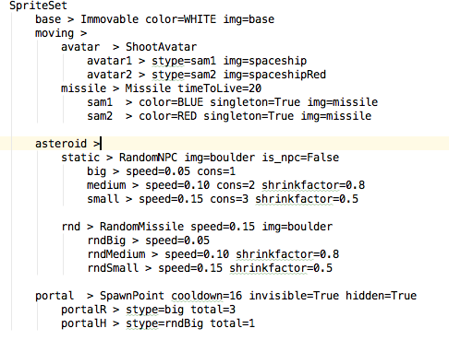
2-Player VGDL
VGDL (Asteroids SpriteSet):

Slide 42
2-Player VGDL
VGDL
Interaction Set: defines the interactions that can occur in the game.
Two sprite names
(Or more: contracted interactions)
Effect name (defined in the ontology – Java class)
Each effect allows certain parameters:
Common: scoreChange, repeat, enabled
Specific: stype, pixelPerfect
Effects are executed sequentially every tick.

Slide 43
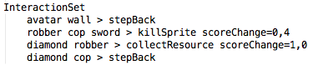
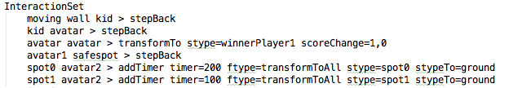
2-Player VGDL
VGDL (CropsNRobbers and Gotcha InteractionSet):

Slide 44
2-Player VGDL
VGDL
Termination Set: determines the conditions that finish the game and winner(s).
Termination type:
Timeout, TimeoutScoreCount,SpriteCounter, MultiSpriteCounter
Parameters: stype, limit, win, scoreCount
Allows multiple conditions.
Checked in sequence.
Default engine ending: (all) lose after 2000 ticks.
Check core.competition.CompetitionParameters.java: MAX_TIMESTEPS variable

Slide 45
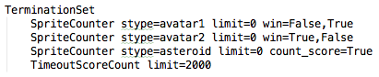
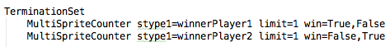
2-Player VGDL
VGDL (Asteroids and Steeplechase TerminationSet):

Slide 46
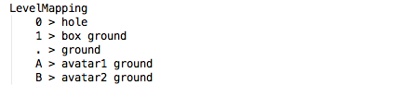
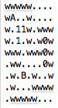
2-Player VGDL
VGDL
Level Mapping: maps characters to sprite types
Upper case letters reserved for avatars
One character can map to N sprites.
Sokoban level mapping and level:

Slide 47
2-Player Agents
Agents:
Agent.java
Inherits from AbstractMultiPlayer.java
Constructor:
StateObservationMulti
ElapsedCpuTimer (1s)
PlayerID (0 .. 1)
Act: StateObservationMulti and ElapsedCpuTimer (40ms)
Documentation: https://github.com/GAIGResearch/GVGAI/wiki/Creating-Multi-Player-Controllers
Search for them in: tracks.multiPlayer.*

Slide 48
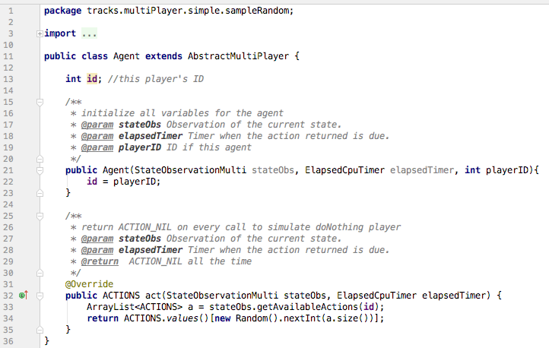
2-Player Agents
Sample Random Controller:

Slide 49
2-Player Agents
What do the agents see?
State of the game:
Game tick, game over, world dimensions.
https://github.com/EssexUniversityMCTS/gvgai/wiki/Querying-the-state-of-the-game-(2-Player)
State of the avatar:
Position, speed, orientation, resources.
Score and winner
All by player ID
https://github.com/EssexUniversityMCTS/gvgai/wiki/Information-about-the-state-of-the-Avatars-(2-Player)
Available actions, by player ID
History of events (collisions) in the game.
Other sprites:
Observation grid.
Categorized observations (NPC, Portal, static sprites…)

Slide 50
2-Player Agents
How do the agents act?
2-Player games have simultaneous moves.
Forward model:
copy()
advance(Types.ACTIONS[] actions)
array of actions for all players in the game,
index in the array corresponding to playerID.
Sample controllers:
src/tracks/multiPlayer/simple: doNothing, random, oneStepLookAhead
src/tracks/multiPlayer/advanced: MCTS, RHEA, RandomSearch

Slide 51
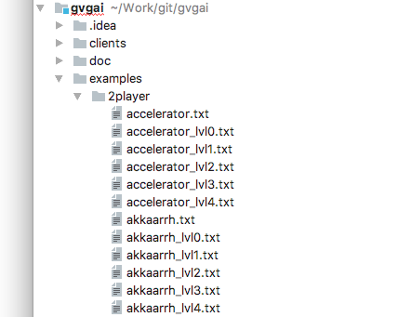
2-Player Games
All games and levels are in:
examples/2player/

Slide 52
Contents
The General Video Game AI Framework and Competition
2-Player GVGAI
Parameterizing GVGAI
Using GVGAI for Game Design
Today’s exercise

Slide 53
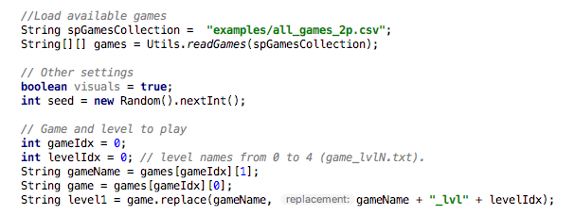
Parameterizing GVGAI
You can play them in:
tracks.multiPlayer.TestMultiPlayer.java

Slide 54
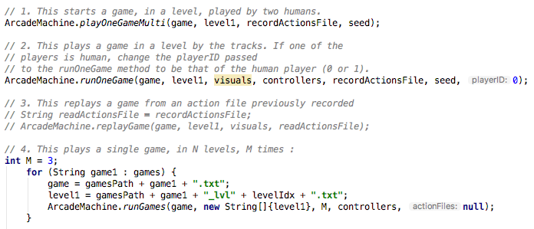
Parameterizing GVGAI
You can play them in (II)
tracks.multiPlayer.TestMultiPlayer.java

Slide 55
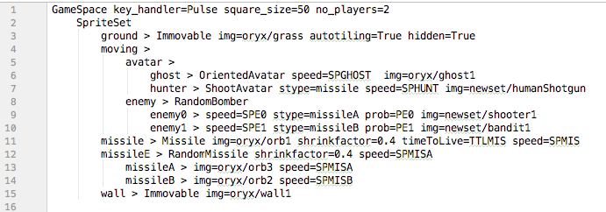
Parameterizing GVGAI
examples/gameDesign/ has version of these games that are parameterizable
SpriteSet of examples/gameDesign/ghostbusters.txt

Slide 56
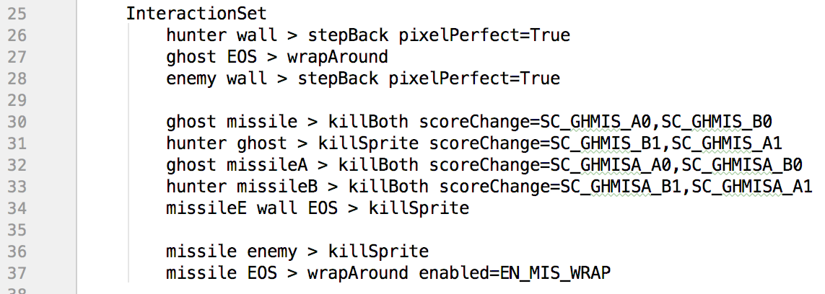
Parameterizing GVGAI
The InteractionSet can be also parameterized:

Slide 57
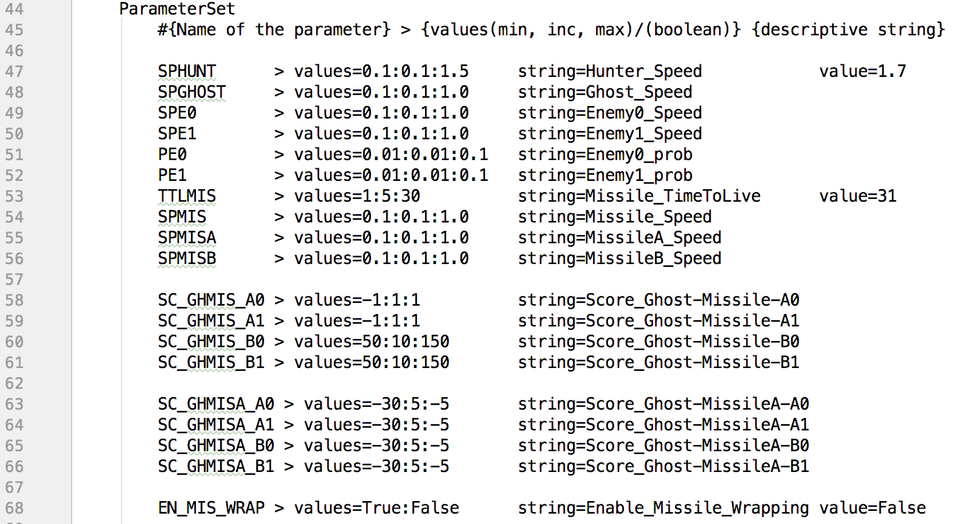
Parameterizing GVGAI
Parameters are defined in a new Set:

Slide 58
Parameterizing GVGAI
How to parameterize:
Components:
Name of the parameter
values: Range and increments of the parameter
string: Human readable name for parameter (no spaces)
value (Optional): sets a final value

Slide 59
Parameterizing GVGAI
Values:
Double, Int or Boolean
Range and increments of the parameter
lower_bound:increment:upper_bound
Example: 0.1:0.1:1.0 -> [0.1, 0.2, 0.3, 0.4, 0.5, 0.6, 0.7, 0.8, 0.9, 1.0]
Example: True:False -> [True, False]

Slide 60
Parameterizing GVGAI
Value:
Same type (no syntax checking)
Can be outside range
Good for testing and setting final value
Optional: If no value is indicated, it will be sampled from values.

Slide 61
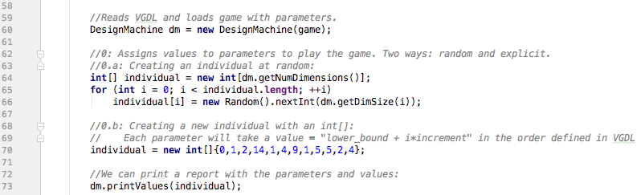
Parameterizing GVGAI
Running Game Spaces:
tracks.gameDesign.TestMultiGameSpace.java
Creating a game:
Example of int[] initialization:
‘2’ for values=0.1:0.1:1.0 -> 0.1 + 2*0.1 = 0.3

Slide 62
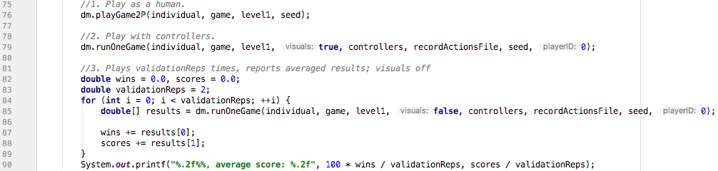
Parameterizing GVGAI
Running Game Spaces:
tracks.gameDesign.TestMultiGameSpace.java
Three execution modes:

Slide 63
Parameterizing GVGAI
(sample video)
https://www.youtube.com/watch?v=eXivet4hnF0

Slide 64
Contents
The General Video Game AI Framework and Competition
2-Player GVGAI
Parameterizing GVGAI
Using GVGAI for Game Design
Today’s exercise

Slide 65
Using GVGAI for Game Design
Goal: Given two simulation depths (D1, D2), we want to generate games where agents with D1 win more often than agents with D2
Evolve the parameters of the game Aliens in order to favour:
Agents with long simulation depth vs short
Agents with short simulation depth vs long
How do those games look like? What game parameters favour for good reactive agents / longer look-aheads?
Notes:
Diego IN

Slide 66
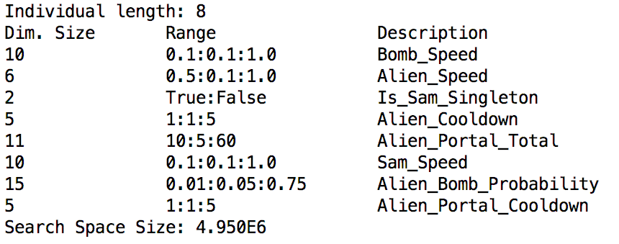
Experimental Example
Parameter (search) Space:

Slide 67

Experimental Example
Algorithm: N-Tuple Bandit EA
Fitness function:
Play game with agent using D₁
Play game with agent using D₂

Slide 68
Experimental Example
Agent: Rolling Horizon Evolutionary Algorithm
10 runs with D₁= 20, D₂ = 5 (20-5)
10 runs with D₁= 5, D₂ = 20 (5-20)
10000 evaluations each.
Neighbours: 100; k-explore: sqrt(2)
Validation: 20 games played with D₁ and D₂, with 20 different fixed seeds.

Slide 69

Training Results
Average of 10 runs, fitness per evaluation

Slide 70


Training Results
Average of 10 runs, cumulated average

Slide 71


Training Results
10 runs, cumulated average

Slide 72

Validation Results
10 recommended games (20-5; Best Sampled)

Slide 73

Validation Results
10 recommended games (5-20; Best Evaluated)

Slide 74

Evolved Games (20-5)
Test in 20 new seeds:
Agent | % Victories | Average Score (std err) | Game length / Timesteps (std err)
RHEA (D=20) | 100% | 61.65 (0.92) | 101.85 (4.45)
RHEA (D=5) | 5% | 65.45 (1.17) | 133.65 (1.79)

Slide 75

Evolved Game (20-5) Sample
Notes:
Visually, game 20-5 is fast with lots of missiles. The player just has a few opportunities to kill all the aliens before the rain of bullets kills it for sure. Games are typically short,because it's killed or be killed. Example video: https://youtu.be/PWHGM_Bd6Jw

Slide 76

Evolved Games (5-20)
Test in 20 new seeds:
Agent | % Victories | Average Score (std err) | Game length / Timesteps (std err)
RHEA (D=20) | 0% | 29.05 (4.19) | 98.8 (8.28)
RHEA (D=5) | 100% | 124.7 (0.84) | 344.55 (14.38)

Slide 77

Evolved Game (5-20) Sample
Notes:
The game 5-20 is different. There are many more aliens and they move fast, but their firing rate is smaller so a very reactive agent can dodge the bullets. Games are longer - it'd make sense if the player is more concentrated in dodging bullets than shooting to kill (and also corroborated by the timesteps shown in the numbers above). Example video: https://youtu.be/t6usa_f9jig

Slide 78

Modelling Player Experience

Slide 79
Afternoon lab individual / groups
Individual or in groups
Download GVGAI Framework:
https://github.com/GAIGResearch/GVGAI/archive/master.zip
You may choose what to do with GVGAI:
Maybe design a new game in VGDL
Maybe modify an existing game in the framework with an interesting twist.
Or to have a competitive and parameterizable 2-player game by the end of the afternoon, with at least one level. You can take one of the existing games and make it parameterizable.
Or play with one of the tracks to participate in the competition.
Note the following guidelines:
You must use the currently defined ontology.
In 2-player games, there should be a clear and necessary interaction between both players.
We should expect that a more complex sample controller (OLMCTS, MCTS, GA) plays better than the simpler ones (OneStep, Random).
Show and Tell session @4.30pm this afternoon

